Slide 1

Photon and Neutron facilities in EOSC
PaNOSC and National RIs

Slide 2
PaNOSC Proposal
Partners : ESRF, ILL, XFEL.EU, ESS, CERIC-ERIC, ELI, EGI
Collaborations: GÉANT, EUDAT, national Ris
Linked 3rd Parties: DESY, STFC
Submitted : 22 March 2018
Budget : 12 million euros
Start Date : 1/1/2019
Length : 4 years
Decision : Accepted on 13/8/2018
Status : preparing Grant Agreement

Slide 3
PaNOSC OBJECTIVES
For Photon and Neutron (PaN) sources on the ESFRI roadmap :
Generalise data management complying to the FAIR principles to provide Open Data
Provide data analysis and simulation services for local and remote users to make maximum use of their data
Integrate PaN data catalogues and services into the EOSC with help of the e-Infrastructures (EGI, GEANT, EUDAT)
For national RIs PaNs
Share policies and solutions of PaNOSC (e.g. catalogues, data analysis + simulation services) with national RIs
Strive to have common approaches, policies and solutions for data management

Slide 4
What PaNOSC is NOT
For Photon and Neutron (PaN) sources on the ESFRI roadmap :
NOT Providing all resources for data management – partners still have to provide infrastructure and additional manpower to implement and sustain data management
NOT Implementing all PaN data analysis and simulation services
For PaNs which are national RIs
NOT Providing resources or infrastructure for implementing FAIR data management and integrating the EOSC
Bottom line
National RIs should apply for additional funds to implement FAIR data management, integrating data services, developing missing data services + integrating EOSC

Slide 5
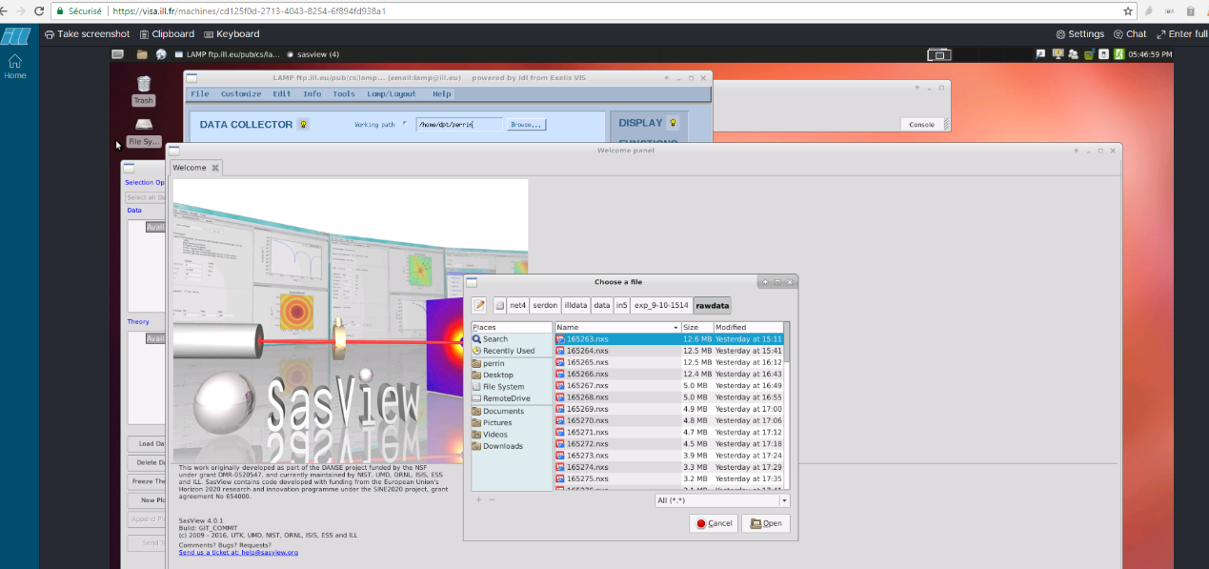
What we want to provide
Curated Open Data and metadata of the highest quality
Reliable services dedicated to understanding and to further exploiting these data
Technical and scientific support on these data and data services
Our experience on FAIR data policies and FAIR implementation guidelines for Photon and Neutron science
Our knowledge and understanding of our scientific community
Our ability to promote FAIR culture amongst our community
Help to build the EOSC and make it useful

Slide 6
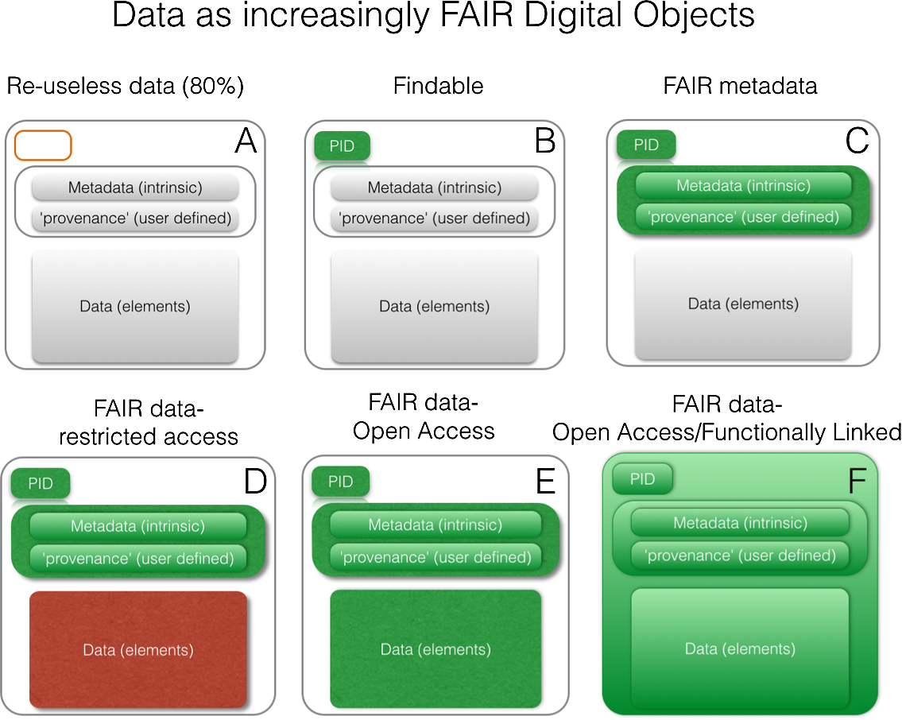
Goal of PaNOSC is to have 100% FAIR data …
DOI 10.3233/ISU-170824

Slide 7
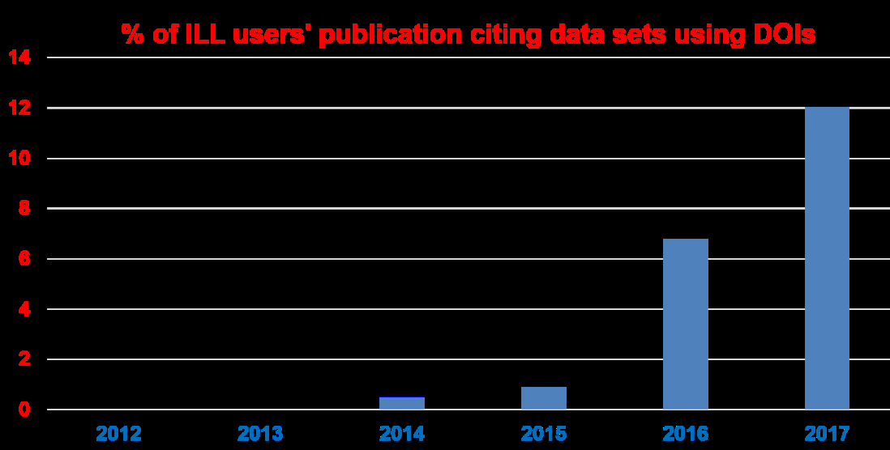
Goal of PaNOSC is 50% of users to cite data using DOIs compared to 0 – 12 % today…

Slide 8
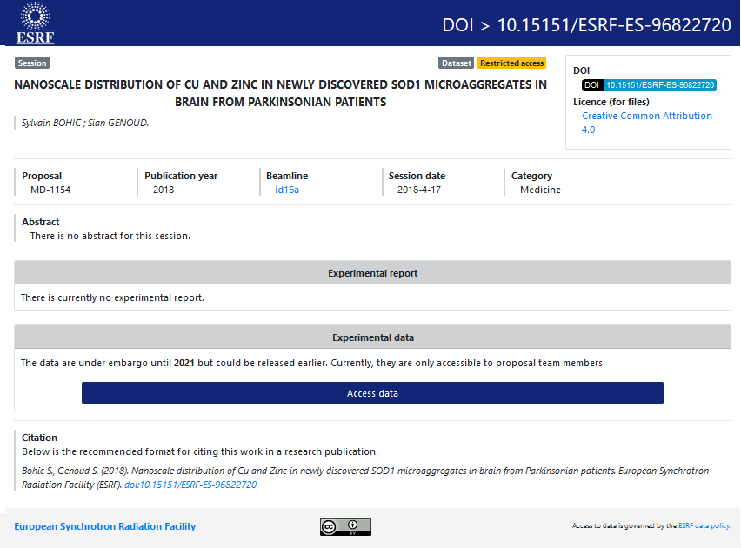
ESRF DOIs
New service
implemented as
part of data policy
and long term
data archiving
https://doi.esrf.fr/
An essential step
for Open Data

Slide 9
Our Goals
Better use of data from PaN sources for all users (no-expert to expert)
Create a new class of virtual users of Open Data from PaNs with EOSC

Slide 10
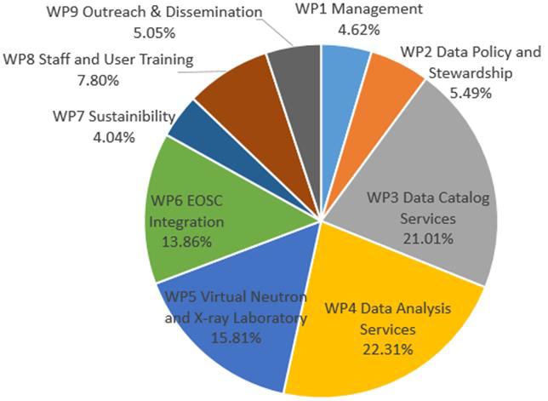
PaNOSC Work packages effort
WP1 – Management (64)
WP2 – Data policy and stewardship (76)
WP3 – Data catalogue services (291)
WP4 – Data analysis services (309)
WP5 – Virtual Neutron and X-ray lab (219)
WP6 – EOSC integration (192)
WP7 – Sustainability (56)
WP8 – User training (108)
WP9 – Outreach (70)

Slide 11
Data Policies
2008 – PaNData policy framework
Adoption by several facilities (ILL, ESRF, PSI, ELETTRA, HZB, …)
Align user experience about policy
PaNOSC: updated Data Policy framework:
Lessons learned from the community
Better understanding of FAIR
Align with other EOSC projects/clusters work on DP.
Common guidelines
Minting DOIs, long term archiving, downloading and citing data, ….
Implementing DMP template

Slide 12
Data Policies
PaNOSC and National RIs collaboration
IDEAS
Adapt and adopt PaNOSC Open Data policy
Implement long term archiving, DOIs,
Adopt DMP template

Slide 13
Data + Metadata
2015 – Nexus data format https://doi.org/10.1107/S1600576714027575
Nexus is the de facto standard (What else ?)
Adopted by most synchrotrons
Not perfect but continuously improving
PaNOSC: adopted Nexus as standard:
Lessons learned from the community
Work closely with Nexus Committee (NIAC)
Collect rich metadata on all experiments
FAIR principles require rich metadata
Common guidelines
Define new metadata standards where missing, share metadata catalogues or definitions based on Nexus, ….
Store data in HDF5 with Nexus conventions

Slide 14
Data + Metadata
PaNOSC and National RIs collaboration
IDEAS
Adopt NeXus, collect metadata
Contribute to NeXus definitions
Generalise the use of HDF5 + tools e.g. web browser

Slide 15
Data Catalogues
https://icat.esrf.fr
https://data.ill.eu …
Standard metadata available via OAI-PMH (service provided by DataCite) indexed by OpenAIRE
Development of an API to allow federation of metadata catalogues and exposure of metadata relevant for the area.
Provisioning Federated Search
Linked with EOSC-Hub data catalogue(s)
Searching all PaNOSC partner sites for available datasets

Slide 16
Data Catalogues
PaNOSC and National RIs collaboration
IDEAS
Contribute to and adopt common cross-site API
Port and deploy common API on top of local catalogues
Share solutions for catalogues e.g. ICAT, SciCat, ISPYB, …

Slide 17
Data Analysis Services
Enabling transition from measurements to insight and new science
Providing raw data is not enough … we also need to provide specific services for extracting scientific knowledge.
Web remote desktop based analysis services
Provide generic solution for analysis software
Web notebook based analysis services
Focus on reproducible and publishable data analysis
Integration into EOSC service portfolio
Moving from single facility to EOSC scope

Slide 18
Data Analysis Services
PaNOSC and National RIs collaboration
IDEAS
Develop new data analysis services
Deploy common data services e.g. Jupyter, VMs

Slide 19
Simulation Services
Simulations of the various parts and processes involved in complex experiments play an increasingly important role in the entire lifecycle of scientific data generated at RIs.
Expose source, beamlines optics and scattering simulations as cloud services
Expose simulation data services in data analysis frameworks accessed via Jupyter notebooks or remote desktop solutions.
Integration into EOSC service portfolio

Slide 20
Simulation Services
PaNOSC and National RIs collaboration
IDEAS
Deploy PaNOSC simulation services (OASYS, VYNIL)
Develop new simulation services e.g. for specific scientific domains like MX, Spectroscopy, CDI, …

Slide 21
Support & Training
Expanding from facilities’ users specific support and training to PaN cluster and EOSC users.
Integrated technical and scientific Helpdesk that will give support to data scientists
E-learning platform (à la e-neutrons)
Staff training in data stewardship
Participate in scientific schools (Hercules) to promote FAIR principles and introduce the use of EOSC services

Slide 22
Support & Training
PaNOSC and National RIs collaboration
IDEAS
Adopt e-learning platform and develop training
Participate in training for data management and software development e.g. as part of Hercules

Slide 23

Working with
Active participation in governance.
Active Participation in open policies activities.
Integration of our data catalogues into the EOSC data catalogue.
Use of E-Infra IT services to deploy more specific services targeted at Photon and Neutron data type and users.
Provisioning of models and solutions to bring small datasets to the compute resources and vice versa for very large datasets.
Commonly defined service quality levels (Service Level Agreements) and if necessary upgrade the services to reach and maintain reliably this level of quality.
Commonly defined usage metrics and the adoption of the necessary tools to collect and publish them.
Harmonization of solutions for federated identity provisioning, authentication and authorization.
Set up a technical and scientific support structure for handling data scientist (not necessarily facility users) requests
Promoting FAIR data culture.

Slide 24
Key challenges with e-infrastructures
Integrating our services into EOSC Hub Service Catalogue
SLA Standards
Metrics and monitoring
Providing compute capacity for DAAS services
Data availability for the services
Moving data to the services (FTS3)
Moving the computing capacity to the data
Integrate PaN Software catalogue into EOSC marketplace
Models for AAI integration (GEANT)
Data archiving pilot (EUDAT)

Slide 25
Together we represent a large community
50,000 users – Biology, Medicine, Materials, Chemistry, Nuclear Physics, Particle Physics, Cultural heritage, Geology … and industrial applications.
State of the art Large Scale Facilities – 5 ESFRI + 25 national RIs (PaNs)
Data policies implementing FAIR principles – PaNdata data policy
10s of Petabytes of scientific data, curated and archived for 5-10+ years
PaNs manage and provide access to data from experiments across Europe
Working together in past and ongoing projects – PaNData, SINE2020, CALIPSOPlus, EUCALL, → LEAPS, …

Slide 26
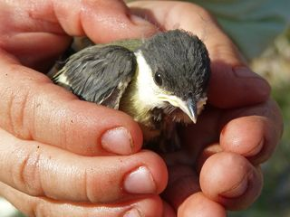
We seek Collaboration with
National RIs on
Data Management, Open Data, EOSC and
Data Analysis + Simulation as a
Service !
There is still a long way
to go before PaN Data
Management can be considered solved
Q: “Is the bird in my hand dead or alive?”
A: “It is what you want it to be!”

